Slide 1

Open Lab Series on AI in Scientific Discovery and Academic Research: Prompt Engineering
Namig Abbasov, Data Science Analytics Unit, ASU Library

Slide 2
Key Objectives
Understand
Understand foundations of AI
Apply
Apply prompt engineering techniques
Use
Use AI tools to support scholarly workflows
Use
Use LLMs for Qualitative Research
Reflect on
Critically reflect on role of AI in knowledge production
Integrate
Integrate AI ethically and transparently in research practice

Slide 3

Open Lab Series Schedule
15 Oct.
Introduction, Prompt Engineering
22 Oct.
LLMs for Scientific Discovery
12 Nov.
LLMs for Qualitative Research

Slide 4
Prompt Engineering
Crafting inputs to guide large language models to generate desired outputs
Understanding Model Limitations
Use of Constraints
Context Provision
Clarity and Specificity
Notes:
https://platform.openai.com/docs/guides/prompt-engineering

Slide 5
Why Prompt Engineering ?
LLMs are powerful but fragile
produce brilliant results or complete nonsense
Easily confused
small wording changes can lead to big output differences
Analogy
LLM is lake of language
Prompt engineering is irrigation system that draws out exactly what you need, where you need it.
Best use of LLMs
“The less the model has to guess at what you want, the more likely you’ll get it.”

Slide 6
Types of Prompt Engineering
Direct prompting (Zero-shot)
Prompting with examples (One-, few-, and multi-shot)
Chain-of-thought prompting
Iterative Prompting
Negative and Positive Prompting
Hybrid Prompting
Prompt Chaining
Role-playing prompting

Slide 7
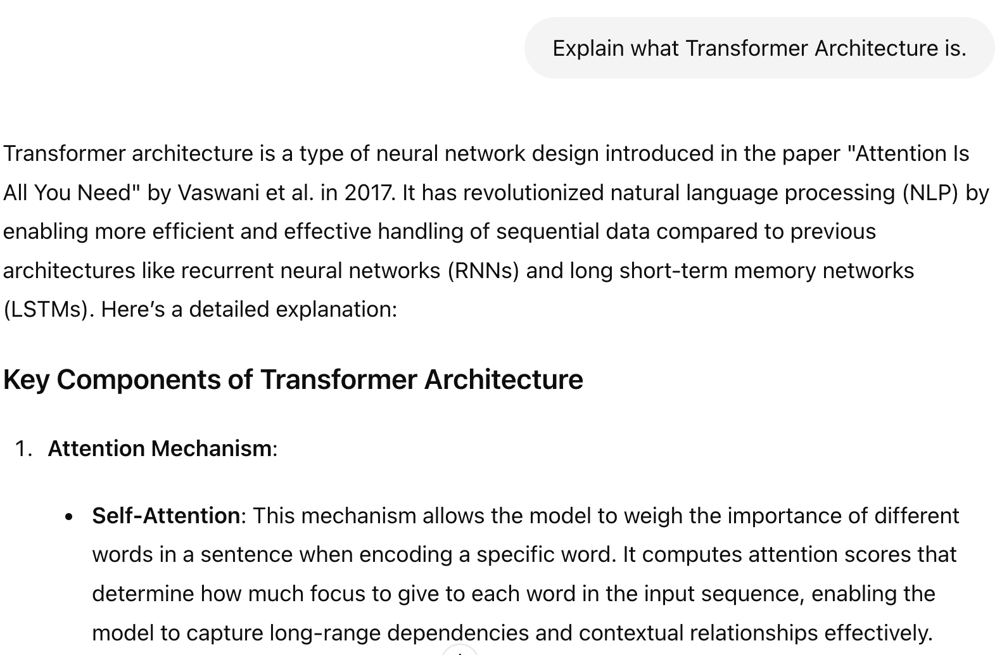
Direct prompting (Zero-shot)
Simplest type of prompt
No examples to models
Just instruction

Slide 8
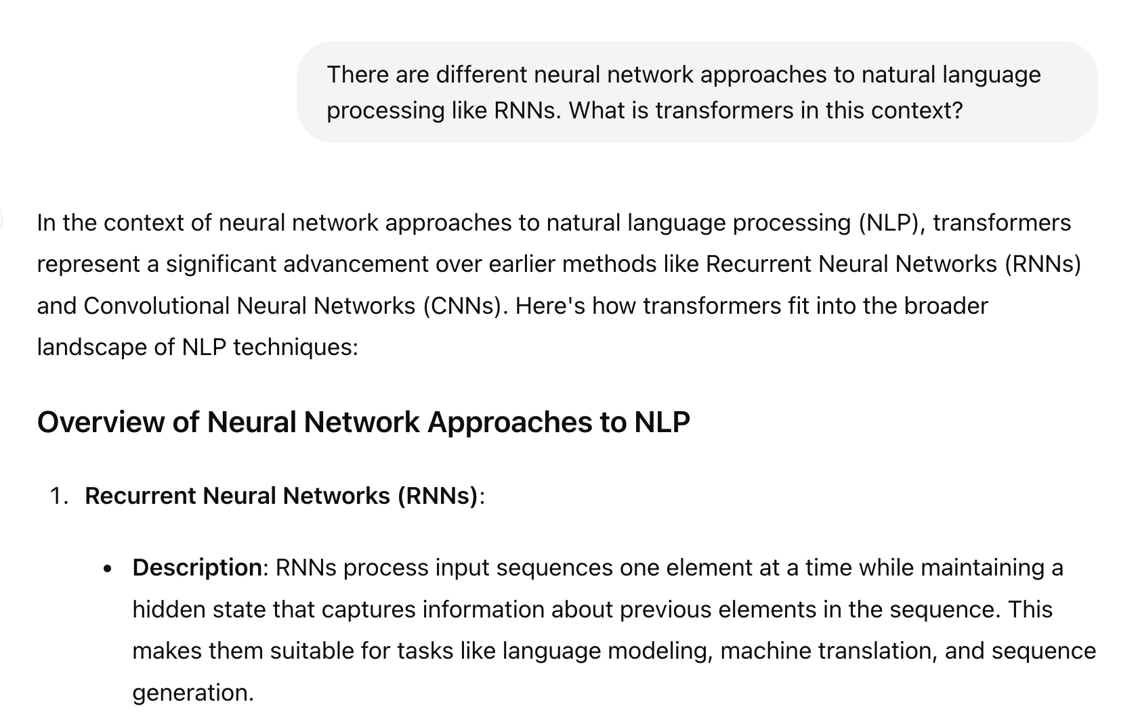
One-Shot Learning: One example along prompt

Slide 9
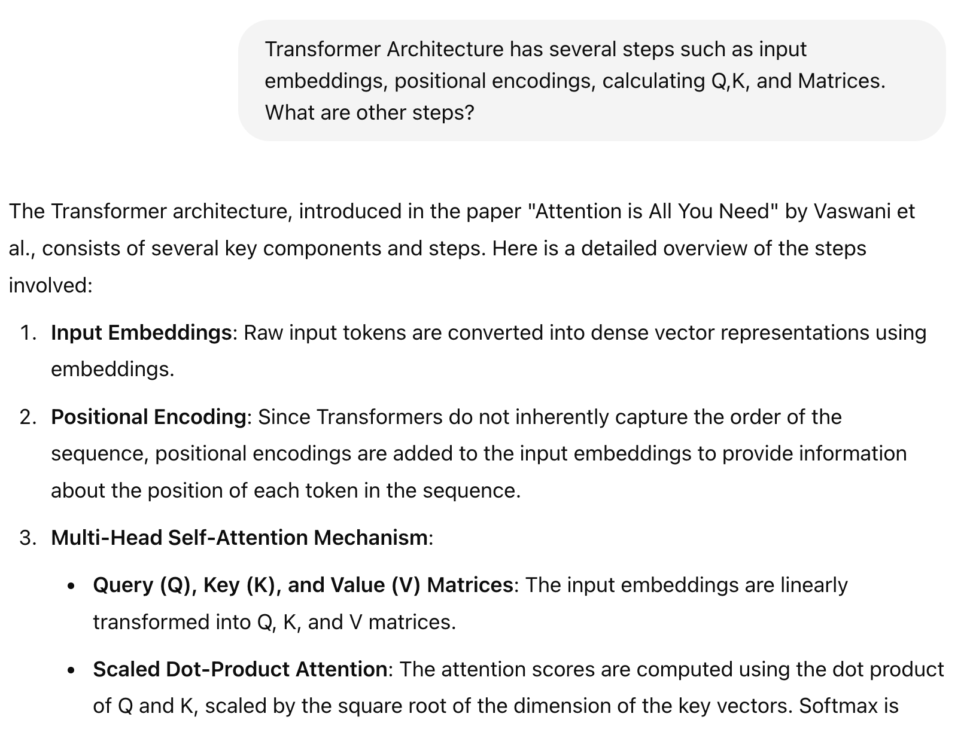
Few-Shot Learning

Slide 10
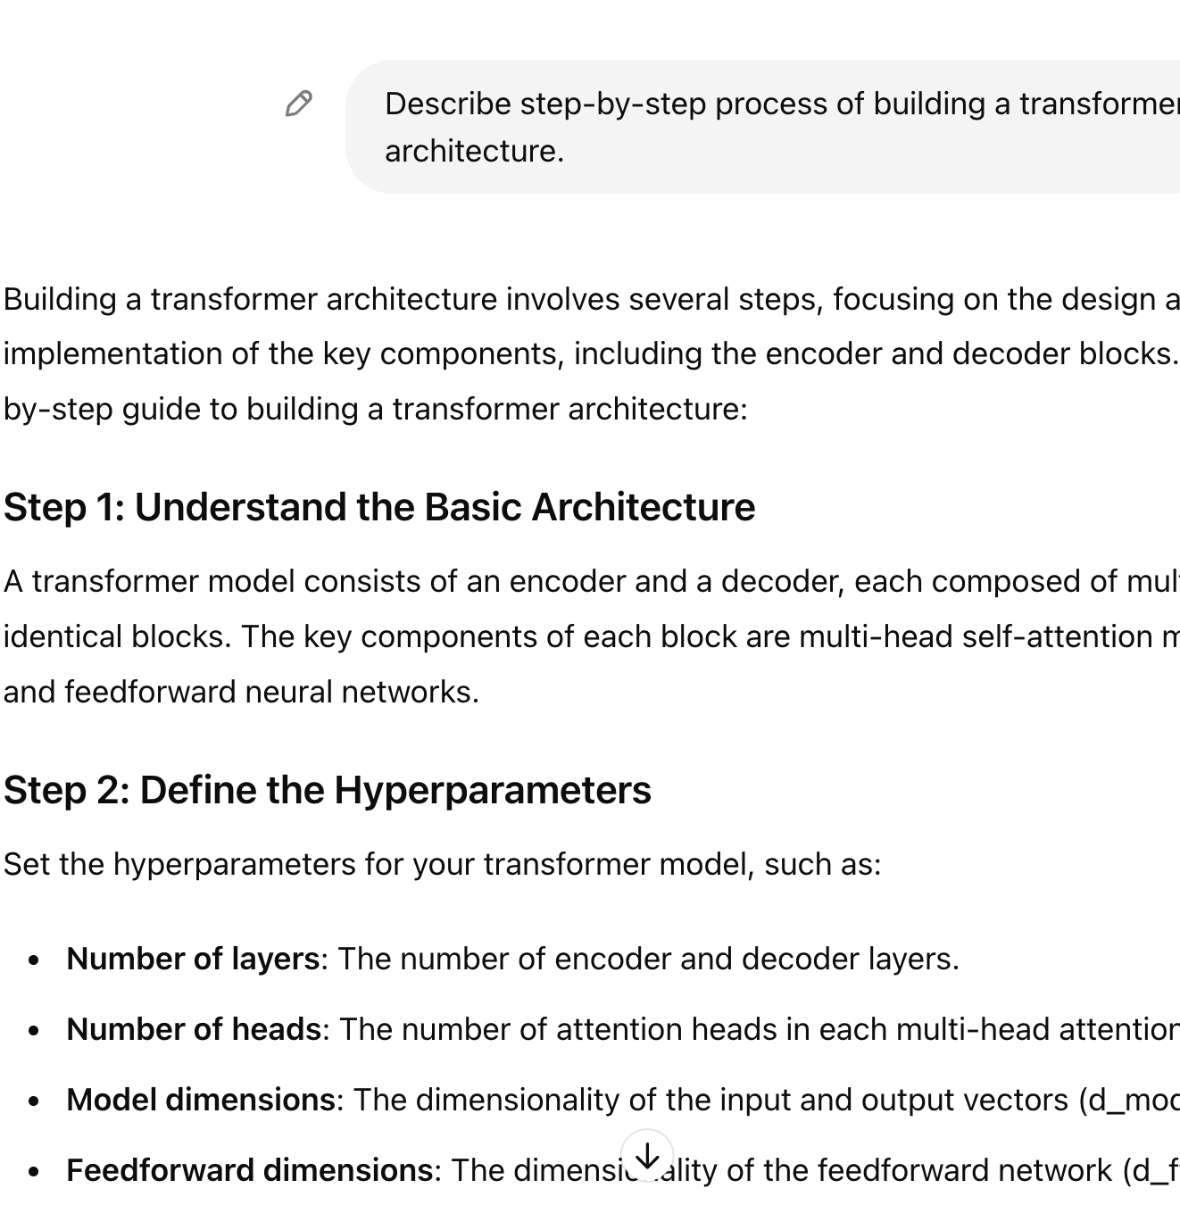
Chain-of-thought
Step-by-Step Reasoning
Clear Prompts
Use Cases
Explicit Steps
Educational Tools
Disadvantage
costly
Wei et al. 2022

Slide 11
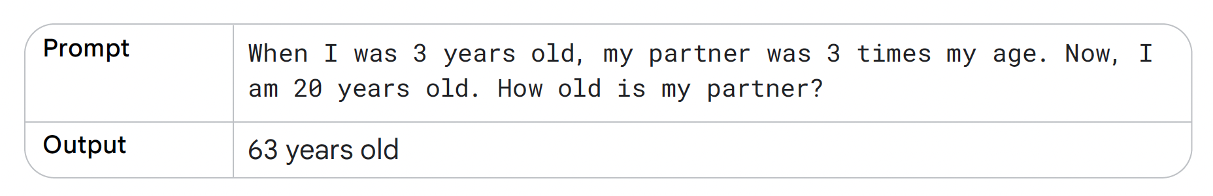
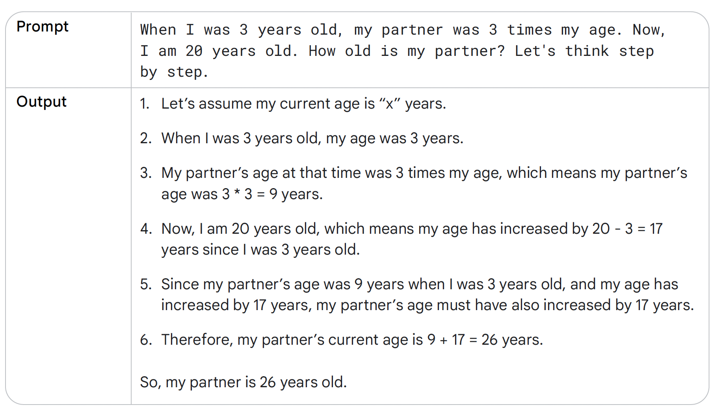
Boonstra 2025

Slide 12
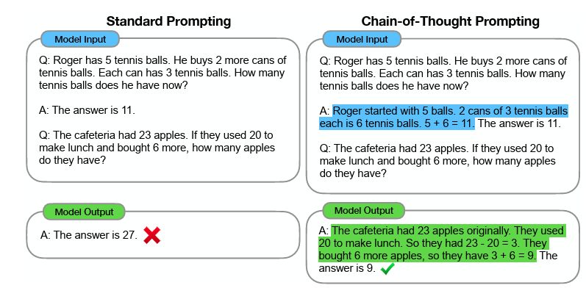
Wei et al. 2022

Slide 13
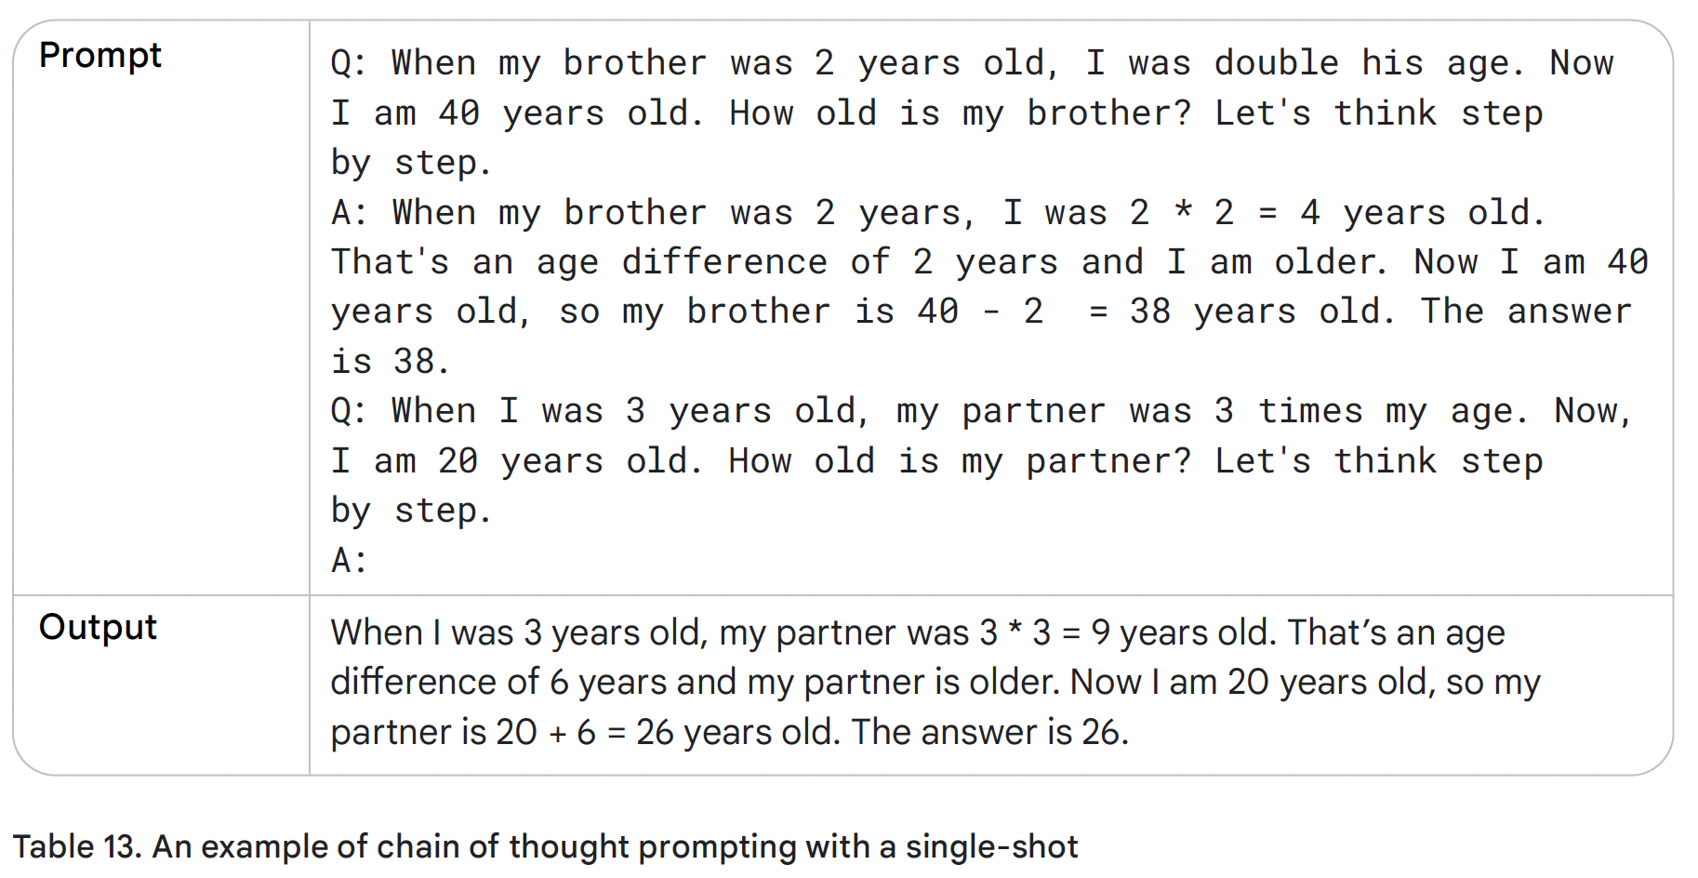
Boonstra 2025

Slide 14
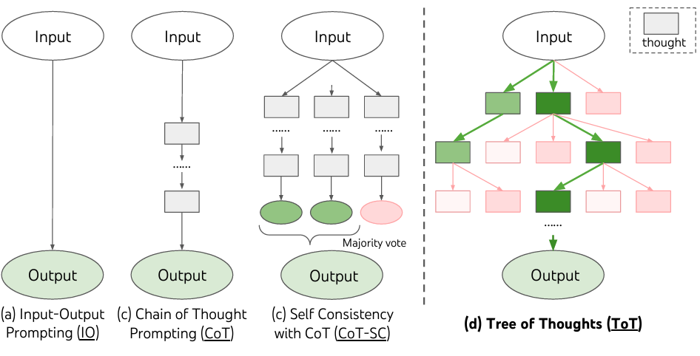
Yao et al. 2023

Slide 15

Iterative Prompting
Initial Prompt
Evaluation and Feedback
Refinement
Re-Prompting
Repeat
For tasks with first unlikely
Multiple adjustments

Slide 16
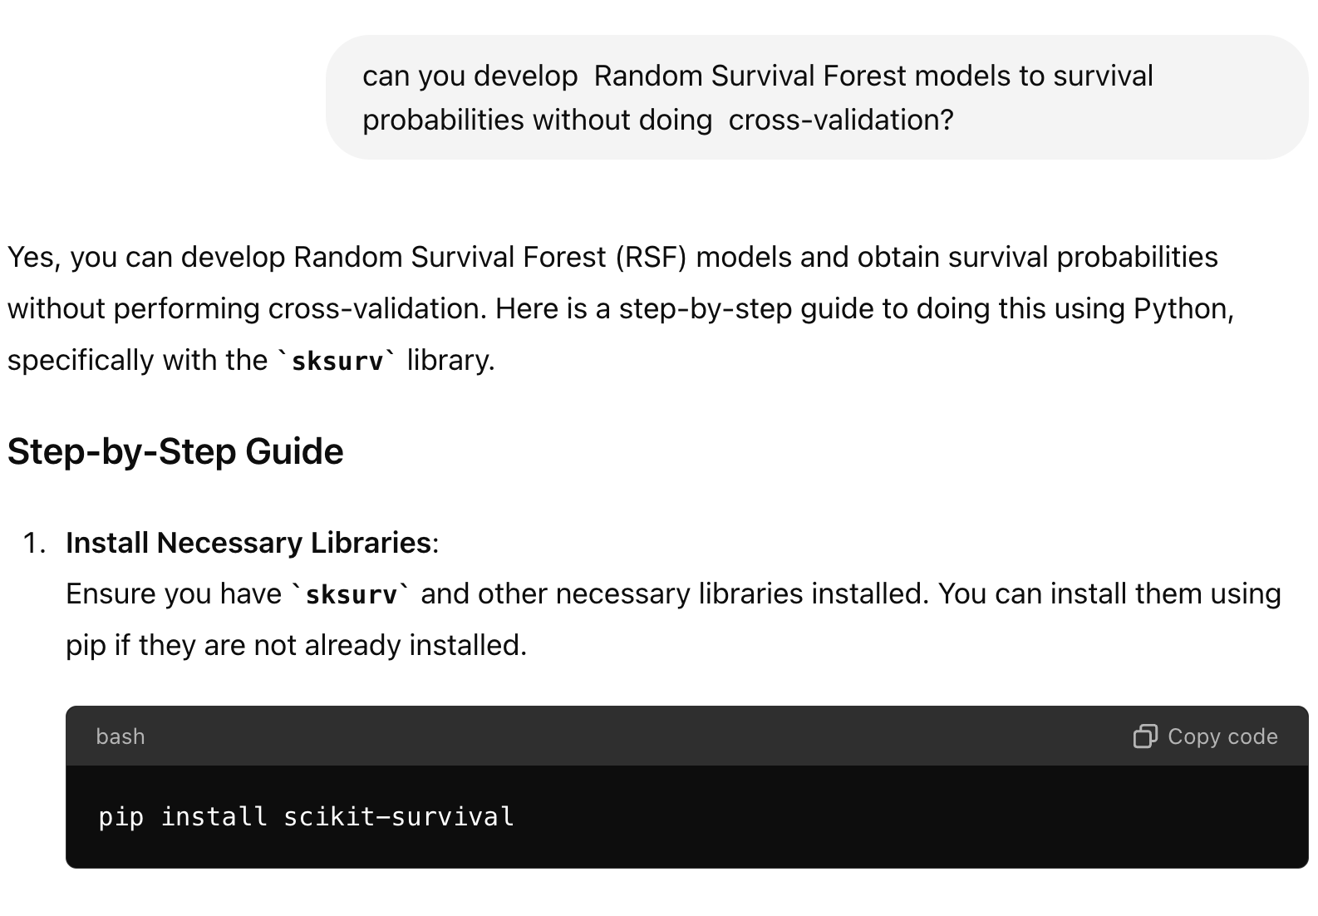
Negative Prompting
What should not be included
Constraints
Improve Relevance
Data Analysis
Content Moderation

Slide 17
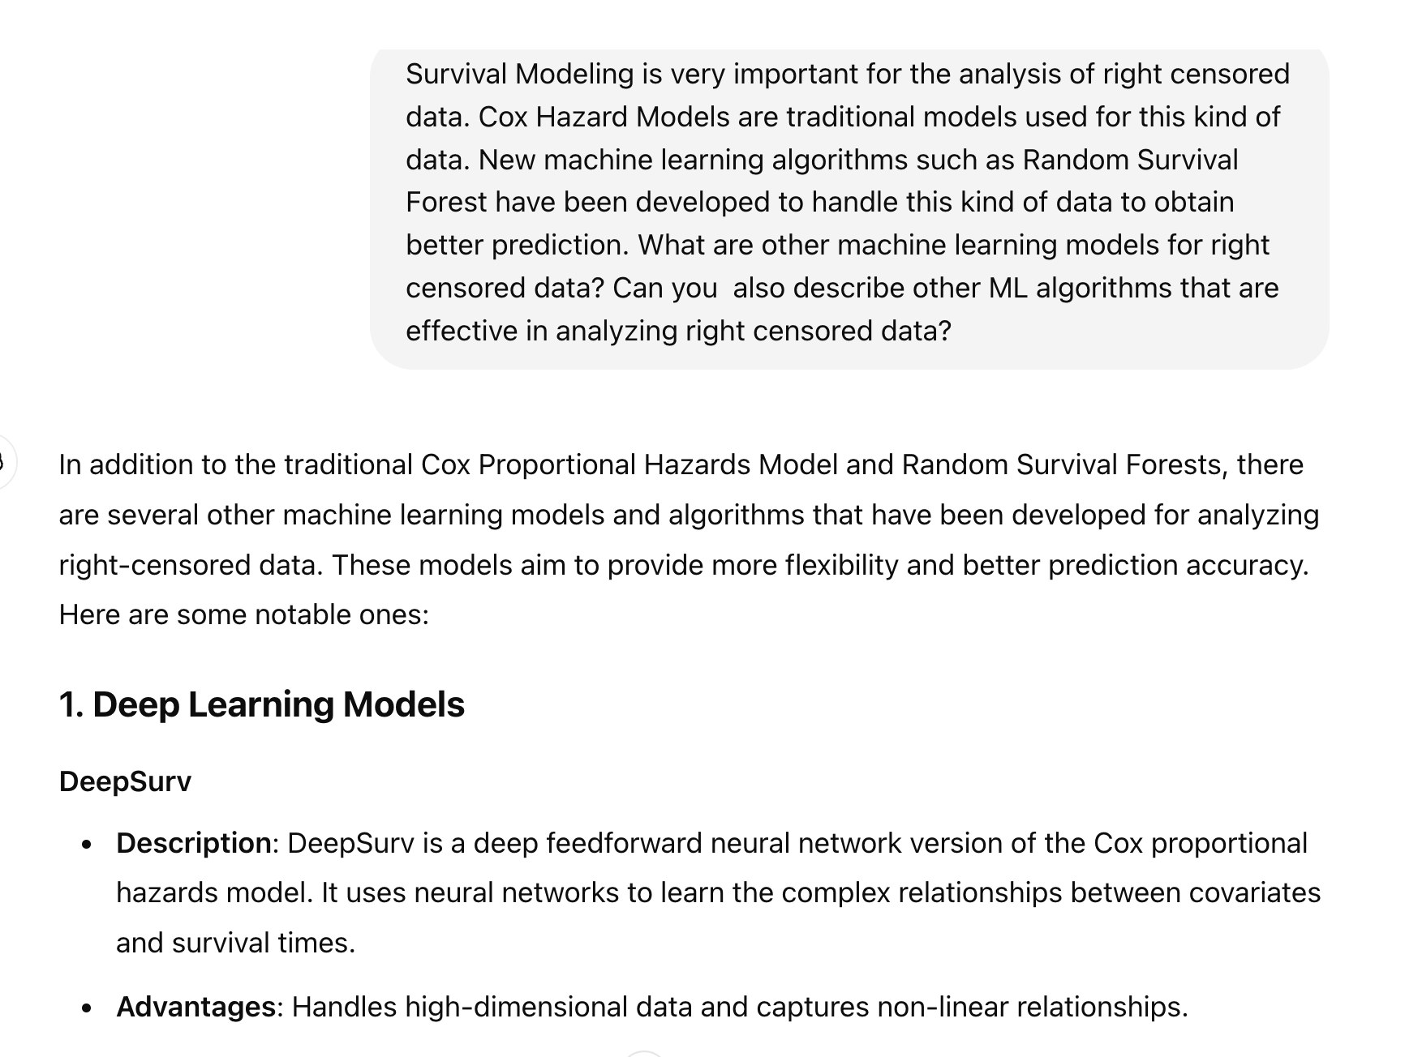
Hybrid Prompting

Slide 18
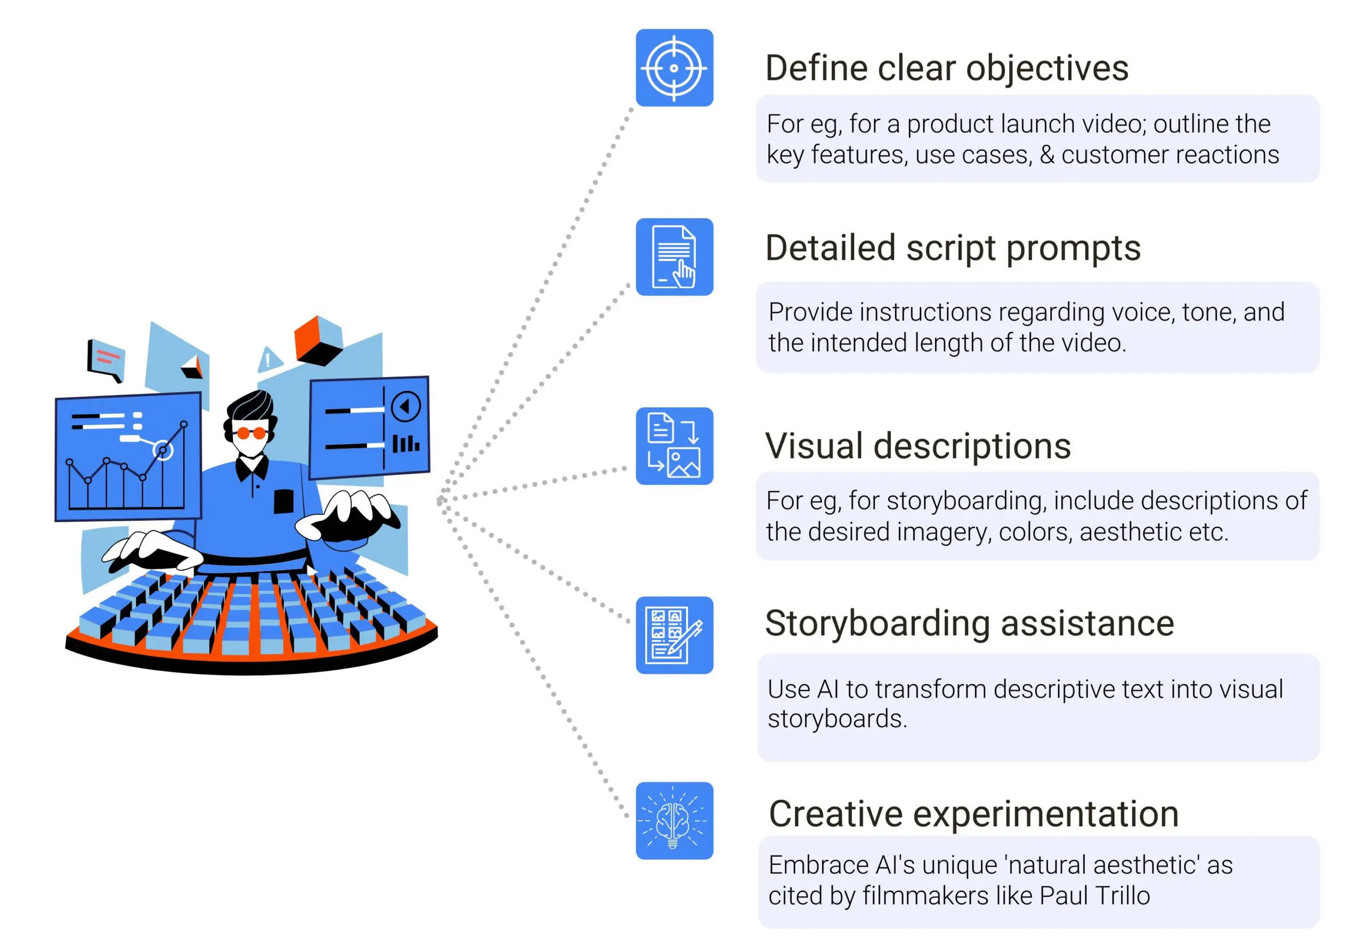
Prompt Engineering Techniques for Video Generation

Slide 19
System, Contextual and Role Prompting
System prompting
overall context and purpose for language model
defines the ‘big picture’ of what model should be doing
Contextual prompting
specific details or background information
understand nuances of what’s being asked
Role prompting
specific character or identity for language model to adopt
generate responses that are consistent with the assigned role

Slide 20
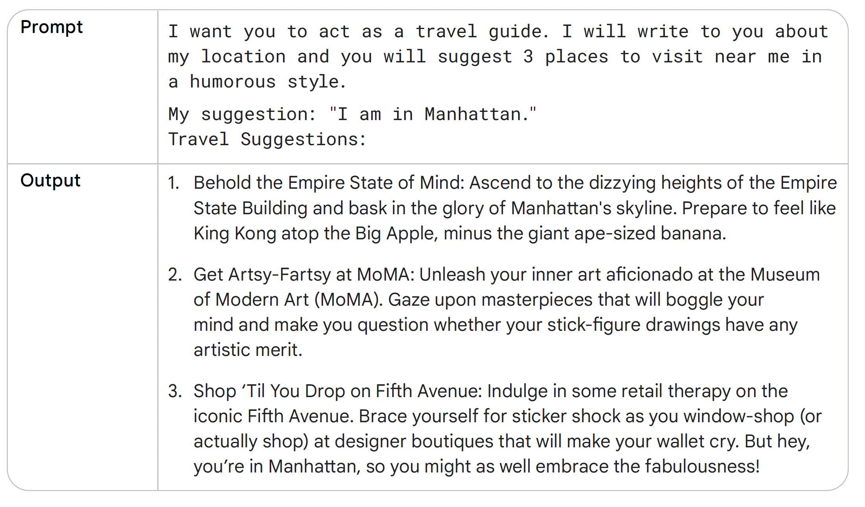

Slide 21
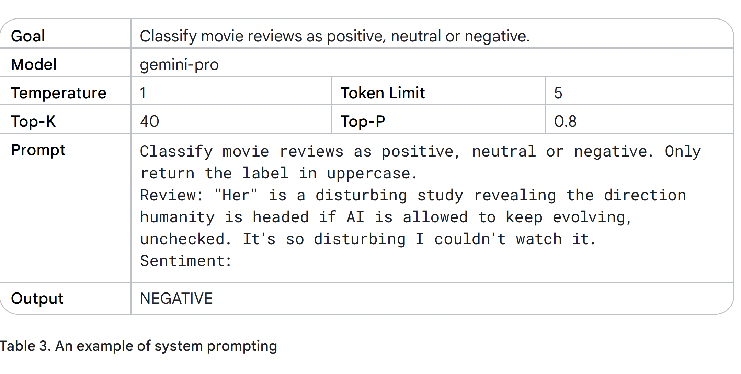

Slide 22
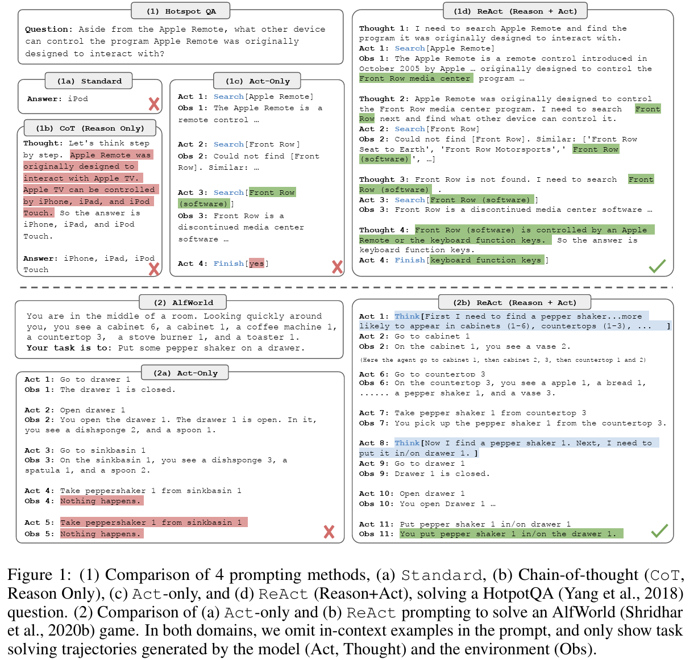
React
Yao et al. 2023

Slide 23
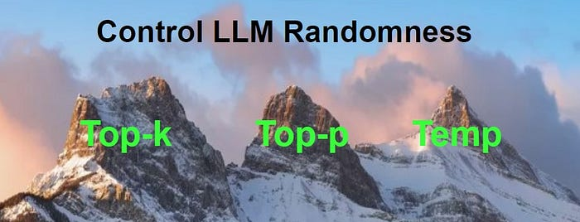
Why Not Always Same Answers: Sampling Controls

Slide 24
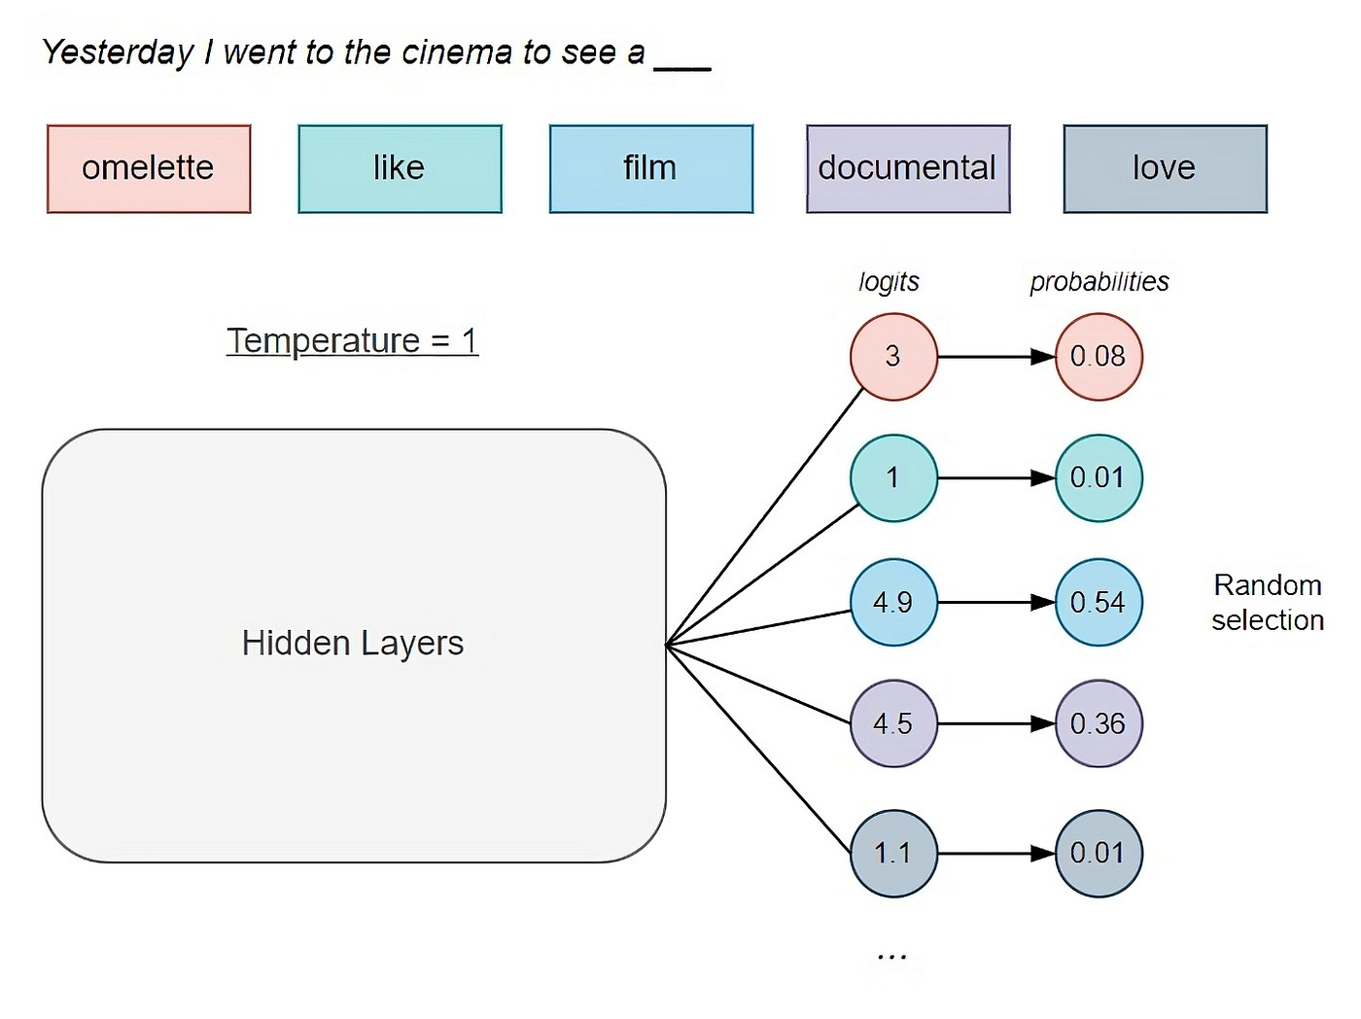
Temperature: Control of Randomness

Slide 25
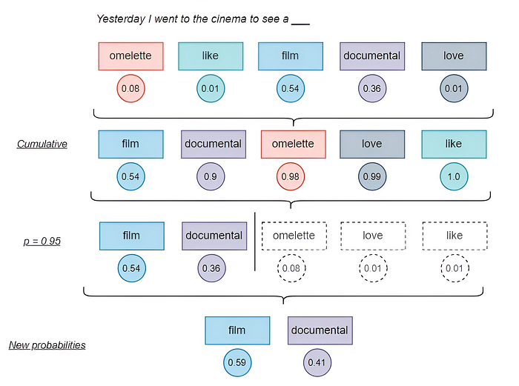
Top-p: Selecting Cumulative Probability

Slide 26
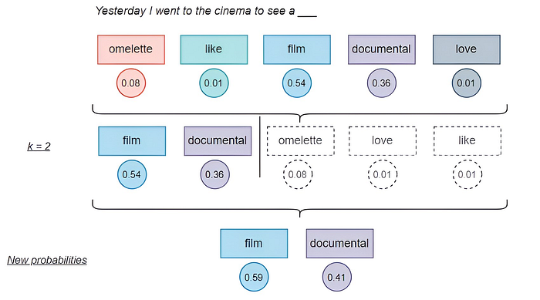
Top-K: Selecting Top Words

Slide 27
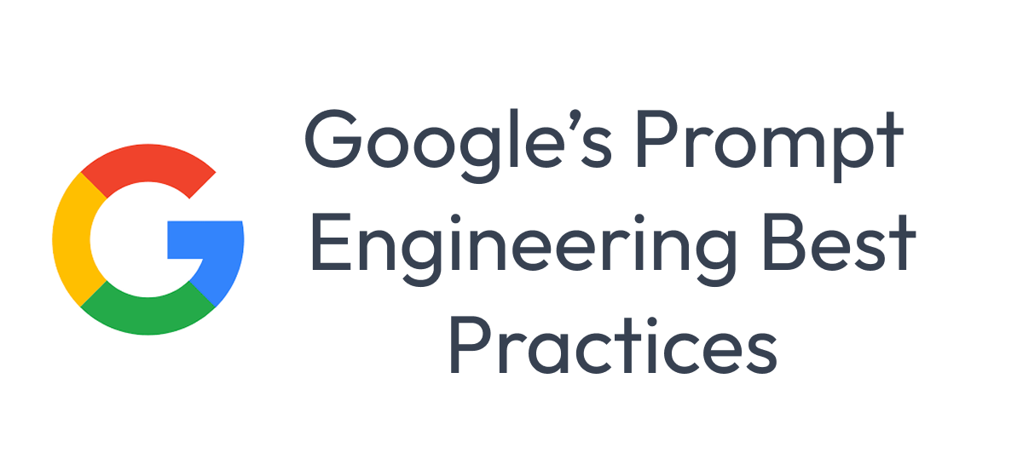
We Will Now Explore Google Prompt Engineering

